Slide 1
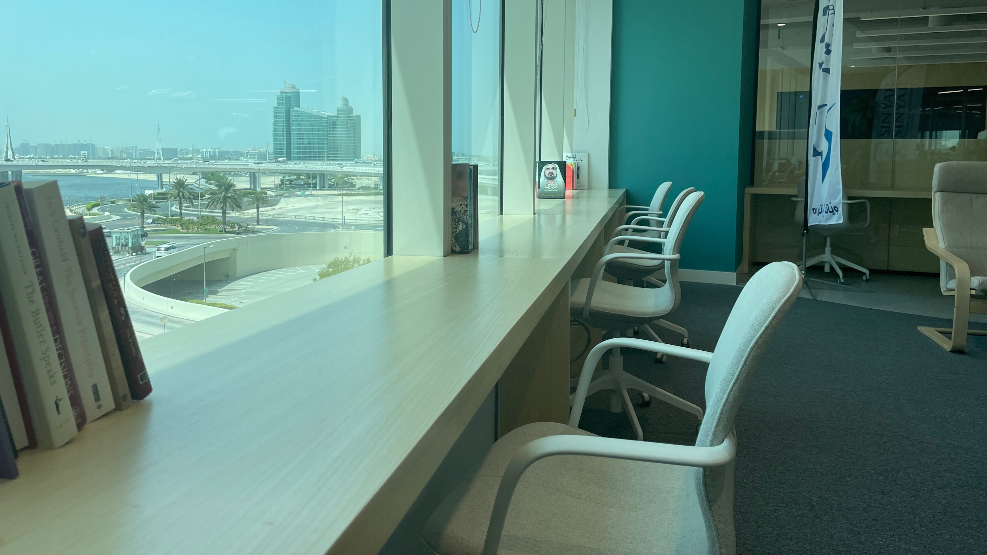

GROW.
GROW.
INNOVATE.
INNOVATE.
INSPIRE.
INSPIRE.

Slide 2

OUTLINE
Click to jump to a section.
SECTION
SECTION
01
02
LEADERSHIP COMPETENCY
MODEL
GROW YOUR
BUSINESS
SECTION
SECTION
03
04
ACTIVATE
INNOVATION
INSPIRE OUR
PEOPLE

Slide 3
GROW . INNOVATE . INSPIRE
WHO IS THE LEADERSHIP COMPETENCY MODEL FOR?
Those holding a managerial or leadership position.
It is a pragmatic roadmap providing transparency and guidance on the expected behaviors of our managers and leaders across the full employee life cycle.

Slide 4



WHAT’S IN THE LEADERSHIP COMPETENCY MODEL AND WHERE DID IT COME FROM?
Designed based on a thorough, comprehensive, and calibrated analysis of best-in-class leadership attributes within the current business context.
The co-creation of the model encompassed leadership representation across all our departments across our divisions.
Focuses on building the Al-Futtaim Leadership Competency Framework.
GROW . INNOVATE . INSPIRE

Slide 5





HOW WILL WE LEVERAGE THE LEADERSHIP COMPETENCY MODEL ?
At Recruitment
Performance Management
Development Planning Leadership 360
Professional Development
& Growth Opportunities

Slide 6
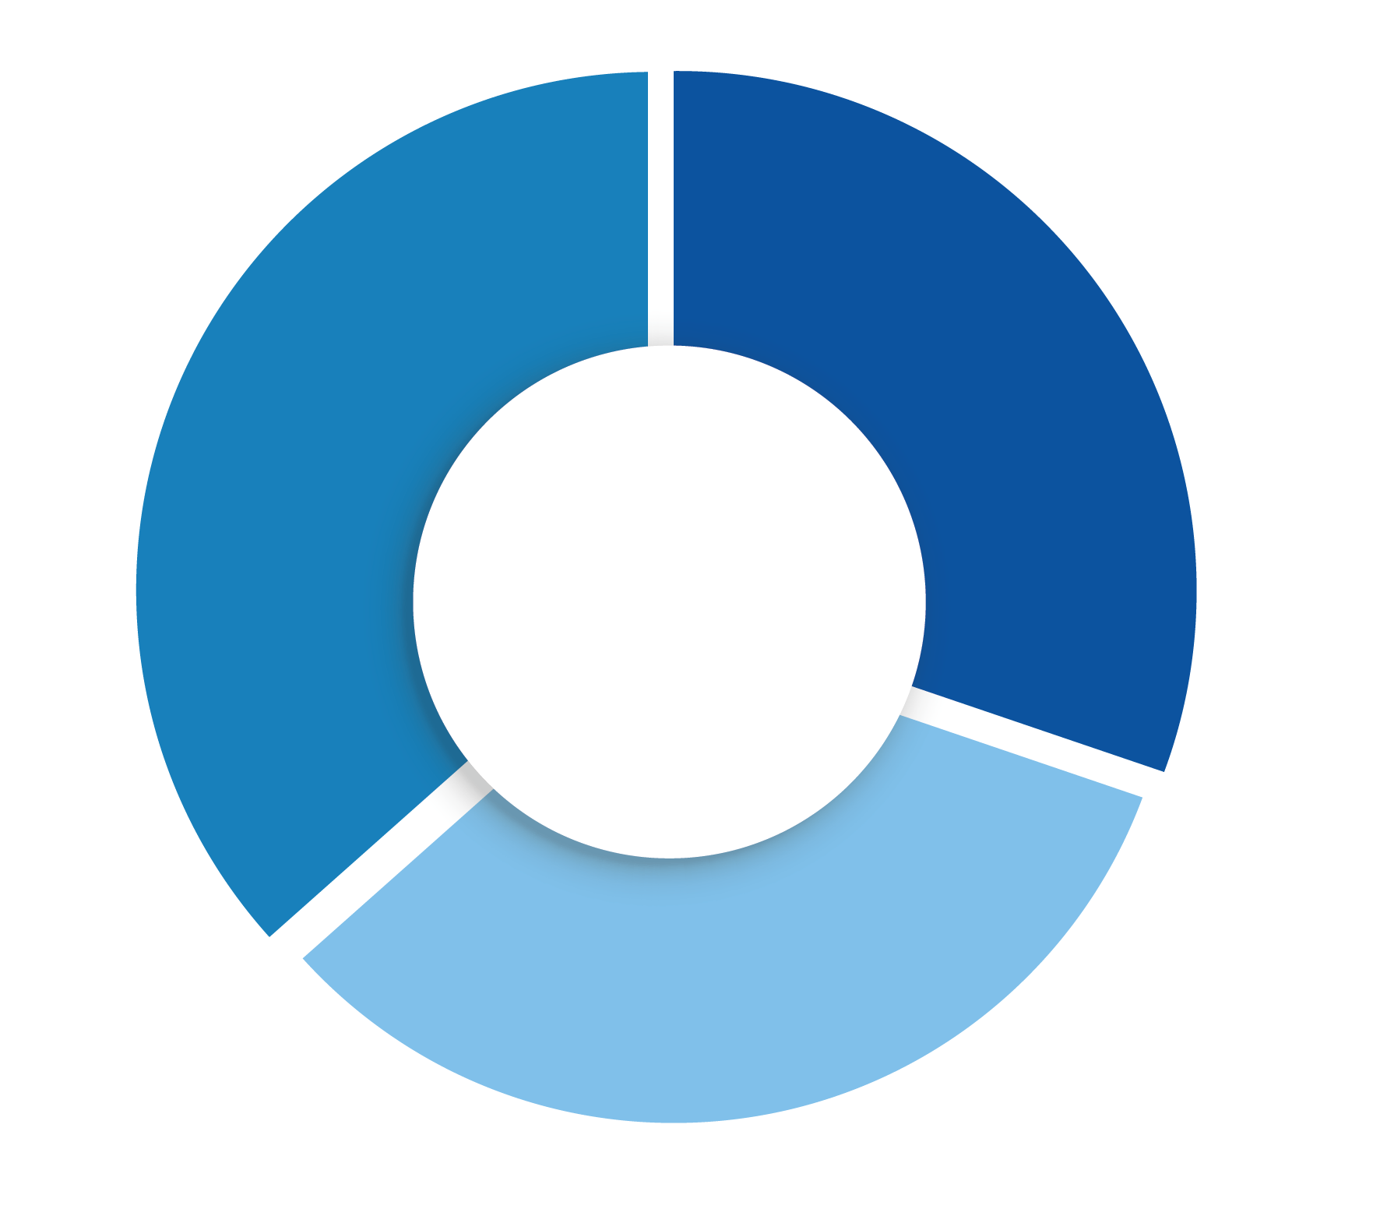
OUR LEADERSHIP MODEL
ACTIVATE INNOVATION
GROW YOUR BUSINESS
Customer Centricity
Future Proofing
Change Agile
Commercial Drive
Goal Driven
Managing Complexity
INSPIRE OUR PEOPLE
Influence and Challenge Engaging Leadership

Slide 7

8 LEADERSHIP COMPETENCIES
FOR SUCCESS
Customer Centricity
Commercial Drive
Works to delight internal and external customers with exceptional service and products, acting as a trusted advisor.
An entrepreneurial mindset; recognize and seize opportunities; take measured risk into account. Focus on initiatives that drive business advancement.
Commercial
Drive
Customer Centricity
Customer centricity
Future Proofing
Goal Driven
Demonstrate an unquestionable willingness to learn everyday, un-learn old approaches, and partner with others to assist them in doing the same.
Results focused, delivering stretching outcomes both as an individual and through teams, with no fear of failure, showing enthusiasm and self-motivation to perform.
We value Respect
Goal Driven
Future Proofing
We value Integrity
We value Collaboration
Change Agile
Managing Complexity
Anticipate and lead change: adapt actions, accordingly, demonstrate tolerance for ambiguity; have a comfort with uncertainty. Shows flexibility in adjusting own views and objectives in order to achieve a shared goal.
Change Agile
We value Excellence
Change Agile
Confident managing the various challenges that our increasingly complex workplace and roles demand: global, digital, competitor, consumer, employees.
Managing Complexity
Managing Complexity
Developing talents
Influence
& Challenge
Engaging Leadership
Influence & Challenge
Engaging Leadership
Create positive momentum by persuading the organization, demonstrating personal courage, and an ability to durably align different opinions.
Inspire people through a compelling vision fueled by a culture of support, enablement and empathy. Building a safe environment for employees to be at their best, feel included and valued.

Slide 8



LEADERSHIP BEHAVIORS
Each of the 8 competencies have been expanded into specific Leadership Behaviors across 3 proficiency levels:
Level 1 (Bands G & H)
Level 2 (Bands I & J)
Level 3 (Bands K & L)
This provides transparency of behavioral and capability expectation as employees grow into more senior leadership roles.

Slide 9
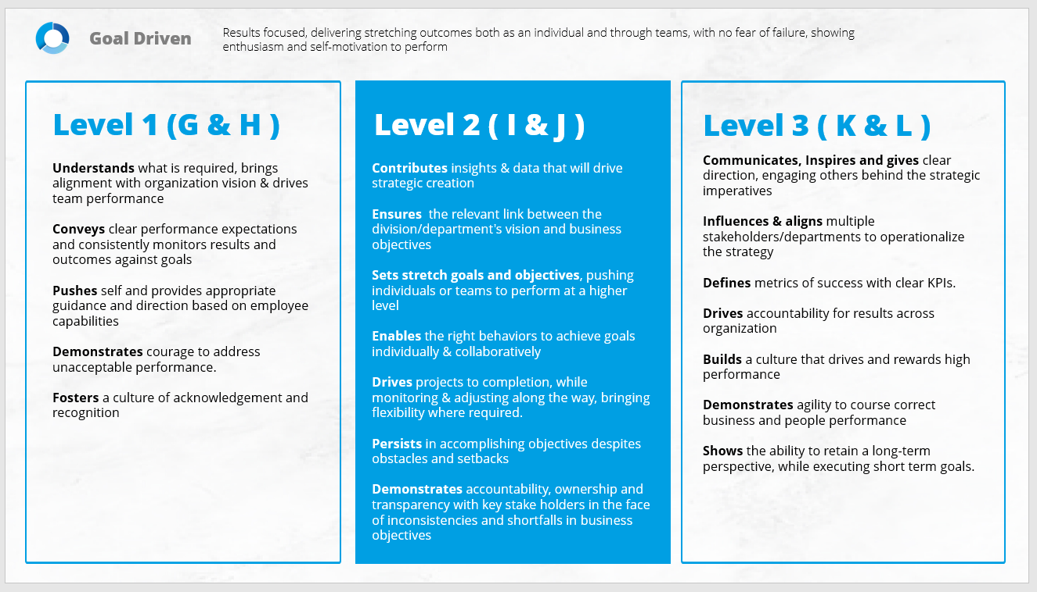
Competency Name
Definition
Leadership Model
Proficiency Level
Leadership Behavioral Anchors

Slide 10
Grow. Innovate. Inspire
Toolkit
01.
02.
Leadership Competencies
Resources
The 8 Leadership Competencies
Leadership Behavioral Anchors for Level 1, 2 & 3
Additional Resources for Context
Application Suggestions

Slide 11
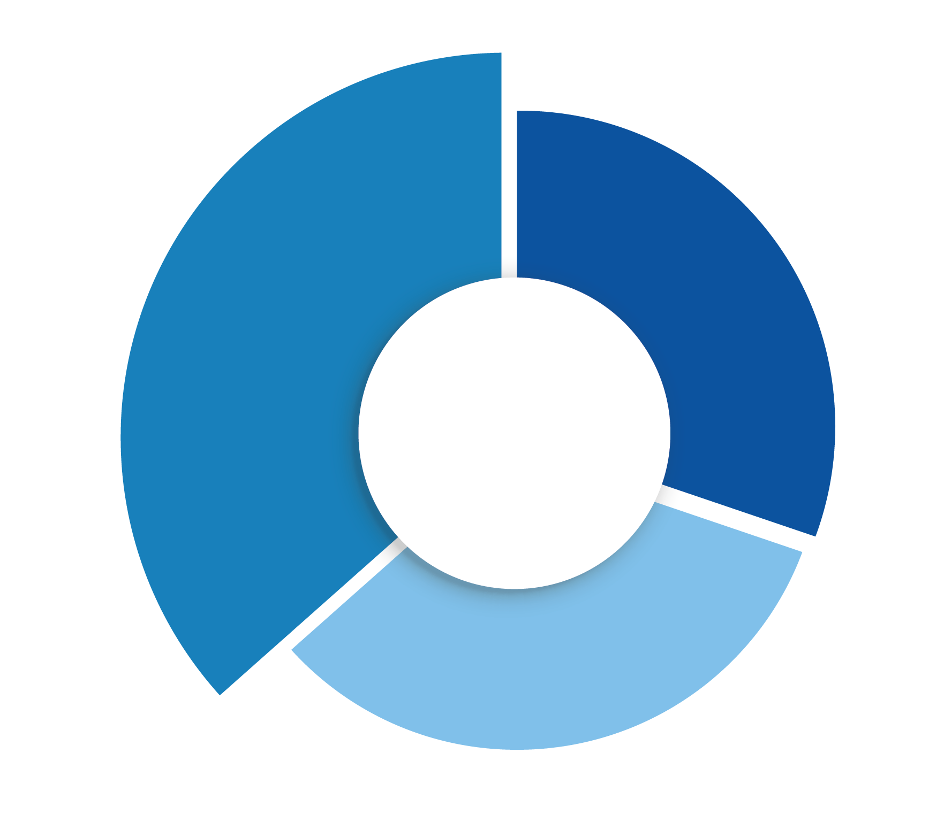



GROW YOUR BUSINESS
GROW YOUR BUSINESS
ACTIVATE INNOVATION
Commercial Drive
Goal Driven
Managing Complexity
INSPIRE OUR PEOPLE

Slide 12

Commercial Drive
An entrepreneurial mindset; recognize and seize opportunities; take measured risk into account. Focus on initiatives that drive business advancement.

Slide 13
Commercial Drive
An entrepreneurial mindset; recognize and seize opportunities; take measured risk into account. Focus on initiatives that drive business advancement.
Level 1 (G & H)
Demonstrates a working knowledge of business and commercial acumen.
Operationalizes and commercializes business processes.
Takes responsibility to implement, execute and align to business requirements.
Looks for efficiencies while working on initiatives and opportunities.
Identifies opportunities for improvement, takes measured risks.

Slide 14
Commercial Drive
Level 2 (I & J)
An entrepreneurial mindset; recognize and seize opportunities; take measured risk into account. Focus on initiatives that drive business advancement.
Demonstrates a working knowledge of managing a P&L and can provide guidance to others undertaking commercial activities.
Demonstrates the ability to operationalize the business strategy optimizing the outcomes.
Balances calculated risk with commercial outcome.
Considers interdependencies of customer profile, market dynamics (consumer insights, market intelligence, socio economic factors) to drive decisions around business opportunities.
Collaborates with different functions to ensure commercial viability of product/service.

Slide 15
Commercial Drive
Level 3 (K & L)
An entrepreneurial mindset; recognize and seize opportunities; take measured risk into account. Focus on initiatives that drive business advancement.
Communicates, designs, and develops a strategy and business model that is commercially viable.
Effectively balances risks and opportunities; and looks for ways to mitigate risks.
Effectively builds and manages relationships with strategic partners.
Demonstrates a strong understanding of the business, market, people and environment to capture and leverage business opportunities.

Slide 16
Commercial Drive
An entrepreneurial mindset; recognize and seize opportunities; take measured risk into account. Focus on initiatives that drive business advancement.
Level 1 (G & H)
Level 2 (I & J)
Level 3 (K & L)
Demonstrates a working knowledge of business and commercial acumen.
Operationalizes and commercializes business processes.
Takes responsibility to implement, execute and align to business requirements.
Looks for efficiencies while working on initiatives and opportunities.
Identifies opportunities for improvement, takes measured risks.
Demonstrates a working knowledge of managing a P&L and can provide guidance to others undertaking commercial activities.
Demonstrates the ability to operationalize the business strategy optimizing the outcomes.
Balances calculated risk with commercial outcome.
Considers interdependencies of customer profile, market dynamics (consumer insights, market intelligence, socio economic factors) to drive decisions around business opportunities.
Collaborates with different functions to ensure commercial viability of product/service.
Communicates, designs, and develops a strategy and business model that is commercially viable.
Effectively balances risks and opportunities; and looks for ways to mitigate risks.
Effectively builds and manages relationships with strategic partners.
Demonstrates a strong understanding of the business, market, people and environment to capture and leverage business opportunities.

Slide 17




Commercial Drive Resources
What are the current business challenges that require prioritization?
What actions and behaviors should I be leveraging/developing to be more commercially focused?
Additional Resources - Articles
Click on each article to learn more.
McKinsey-Commercial Excellence: Your Path to Growth
CIPD-Commercial Drive
https://www.exed.hbs.edu/driving-profitable-growth/
https://psychologyatwork.blog/2020/08/24/developing-a-commercial-mindset/
What are the business outcomes that I can positively impact, if I align my actions with the commercial drive behaviors?
How can I build this understanding into my team members?

Slide 18

Goal Driven
Results focused, delivering stretching outcomes both as an individual and through teams, with no fear of failure, showing enthusiasm and self-motivation to perform.

Slide 19
Goal Driven
Level 1 (G & H)
Results focused, delivering stretching outcomes both as an individual and through teams, with no fear of failure, showing enthusiasm and self-motivation to perform.
Brings alignment with organization vision & drives team performance.
Conveys clear performance expectations and consistently monitors results and outcomes against goals.
Pushes self and provides appropriate feedback & coaching as required.
Demonstrates courage to address unacceptable performance.
Fosters a culture of acknowledgement and recognition.

Slide 20
Goal Driven
Level 2 (I & J)
Results focused, delivering stretching outcomes both as an individual and through teams, with no fear of failure, showing enthusiasm and self-motivation to perform.
Contributes insights & data that will drive strategic agenda.
Ensures the relevant link between the division/department's vision and business objectives.
Sets stretch goals and objectives, pushing individuals or teams to perform at a higher level.
Enables the right behaviors to achieve goals individually and collaboratively.
Drives projects to completion, while monitoring and adjusting along the way, bringing flexibility where required.
Persists in accomplishing objectives despite obstacles and setbacks.
Demonstrates accountability, ownership, and transparency with key stake holders in the face of inconsistencies and shortfalls in business objectives.

Slide 21
Goal Driven
Level 3 (K & L)
Results focused, delivering stretching outcomes both as an individual and through teams, with no fear of failure, showing enthusiasm and self-motivation to perform.
Communicates, inspires, and gives clear direction, engaging others behind the strategic imperatives.
Influences and aligns multiple stakeholders/departments to operationalize the strategy.
Defines metrics of success with clear KPIs.
Drives accountability for results across organization.
Builds a culture that drives and rewards high performance.
Demonstrates agility to course correct business and people performance.
Shows the ability to retain a long-term perspective, while executing short term goals.

Slide 22
Goal Driven
Results focused, delivering stretching outcomes both as an individual and through teams, with no fear of failure, showing enthusiasm and self-motivation to perform.
Level 1 (G & H)
Level 2 (I & J)
Level 3 (K & L)
Brings alignment with organization vision & drives team performance.
Conveys clear performance expectations and consistently monitors results and outcomes against goals.
Pushes self and provides appropriate feedback & coaching as required.
Demonstrates courage to address unacceptable performance.
Fosters a culture of acknowledgement and recognition.
Contributes insights & data that will drive strategic agenda.
Ensures the relevant link between the division/department's vision and business objectives.
Sets stretch goals and objectives, pushing individuals or teams to perform at a higher level.
Enables the right behaviors to achieve goals individually and collaboratively.
Drives projects to completion, while monitoring and adjusting along the way, bringing flexibility where required.
Persists in accomplishing objectives despite obstacles and setbacks.
Demonstrates accountability, ownership, and transparency with key stake holders in the face of inconsistencies and shortfalls in business objectives.
Communicates, inspires, and gives clear direction, engaging others behind the strategic imperatives.
Influences and aligns multiple stakeholders/departments to operationalize the strategy.
Defines metrics of success with clear KPIs.
Drives accountability for results across organization.
Builds a culture that drives and rewards high performance.
Demonstrates agility to course correct business and people performance.
Shows the ability to retain a long-term perspective, while executing short term goals.

Slide 23
Goal Driven
Resources
How can the Goal Driven behaviors help me, and my team re-prioritize, to accelerate business outcomes?
What new actions and behaviors should I integrate in my self-management and team management approaches?
Additional Resources - Articles
Click on each article to learn more.
Indeed-10 Tips for Being More Goal-Oriented at Work
KornFerry-Long-Term Purpose, Short-Term Goals
PositivePsychology-What is Goal Setting and How to Do it Well
A Proven Formula For Successfully Reaching Your 2021 Goals (forbes.com)
How can I leverage the behavioral anchors to achieve my goals?
How do I plan to cascade this mindset to my team members?

Slide 24

Managing Complexity
Confident managing the various challenges that our increasingly complex workplace and roles demand: global, digital, competitor, consumer, employees.

Slide 25

Managing Complexity
Confident managing the various challenges that our increasingly complex workplace and roles demand: global, digital, competitor, consumer, employees.
Level 1 (G & H)
Ability to follow and guide others through processes and SOPs.
Uncovers root causes to difficult problems by asking the right questions.
Shows the ability to seek support and input from the right stakeholders to make sense of the situation and move forward.
Demonstrates self-management and flexibility, while working with ambiguity.
Finds ways to simplify issues and helps others navigate.

Slide 26
Level 2 (I & J)
Managing Complexity
Acquires data and perspectives from multiple and diverse sources (including historical experiences) when solving problems, evaluating the Pros and Cons.
Ability to work with complex structures and workplace models.
Readily distinguishes between what's relevant and what's unimportant, to make sense of complex situations.
Demonstrates self-resilience and seeks to enable resilience in others.
Ability to break complex challenges into workable chunks.
Demonstrates political savviness.
Understands the impact of complexity on others and actively takes steps to provide support.
Confident managing the various challenges that our increasingly complex workplace and roles demand: global, digital, competitor, consumer, employees.

Slide 27
Managing Complexity
Level 3 (K & L)
Confident managing the various challenges that our increasingly complex workplace and roles demand: global, digital, competitor, consumer, employees.
Enables the organization to make sense of complex challenges, analyze perspectives & facilitate the creation of the roadmap/action plans.
Secures alignment of direction, focus and effort whilst navigating complexity.
Demonstrates courage and ability to take calculated risks especially while dealing with ambiguous situations.
Demonstrates political savviness, understands how decisions are made and who influences them, and brings the right stakeholders to the table.

Slide 28
Managing Complexity
Confident managing the various challenges that our increasingly complex workplace and roles demand: global, digital, competitor, consumer, employees.
Level 1 (G & H)
Level 2 (I & J)
Level 3 (K & L)
Ability to follow and guide others through processes and SOPs.
Uncovers root causes to difficult problems by asking the right questions.
Shows the ability to seek support and input from the right stakeholders to make sense of the situation and move forward.
Demonstrates self-management and flexibility, while working with ambiguity.
Finds ways to simplify issues and helps others navigate.
Acquires data and perspectives from multiple and diverse sources (including historical experiences) when solving problems, evaluating the Pros and Cons.
Ability to work with complex structures and workplace models.
Readily distinguishes between what's relevant and what's unimportant, to make sense of complex situations.
Demonstrates self-resilience and seeks to enable resilience in others.
Ability to break complex challenges into workable chunks.
Demonstrates political savviness.
Understands the impact of complexity on others and actively takes steps to provide support.
Enables the organization to make sense of complex challenges, analyze perspectives & facilitate the creation of the roadmap/action plans.
Secures alignment of direction, focus and effort whilst navigating complexity.
Demonstrates courage and ability to take calculated risks especially while dealing with ambiguous situations.
Demonstrates political savviness, understands how decisions are made and who influences them, and brings the right stakeholders to the table.

Slide 29
Managing Complexity Resources
How can I leverage these behaviours, to address business complexities more effectively?
What behaviours do I need to strengthen, to get more effective at managing complexity?
Additional Resources - Articles
Click on each article to learn more.
HBR-Taming Complexity
How to Manage Complexity in Strategy
McKinsey-How do I Manage Complexity in My Organization
Managing complexity with simplicity
Are there areas in my business I can proactively work on to minimize complexity?
How do I plan to support my team members around complexity?

Slide 30
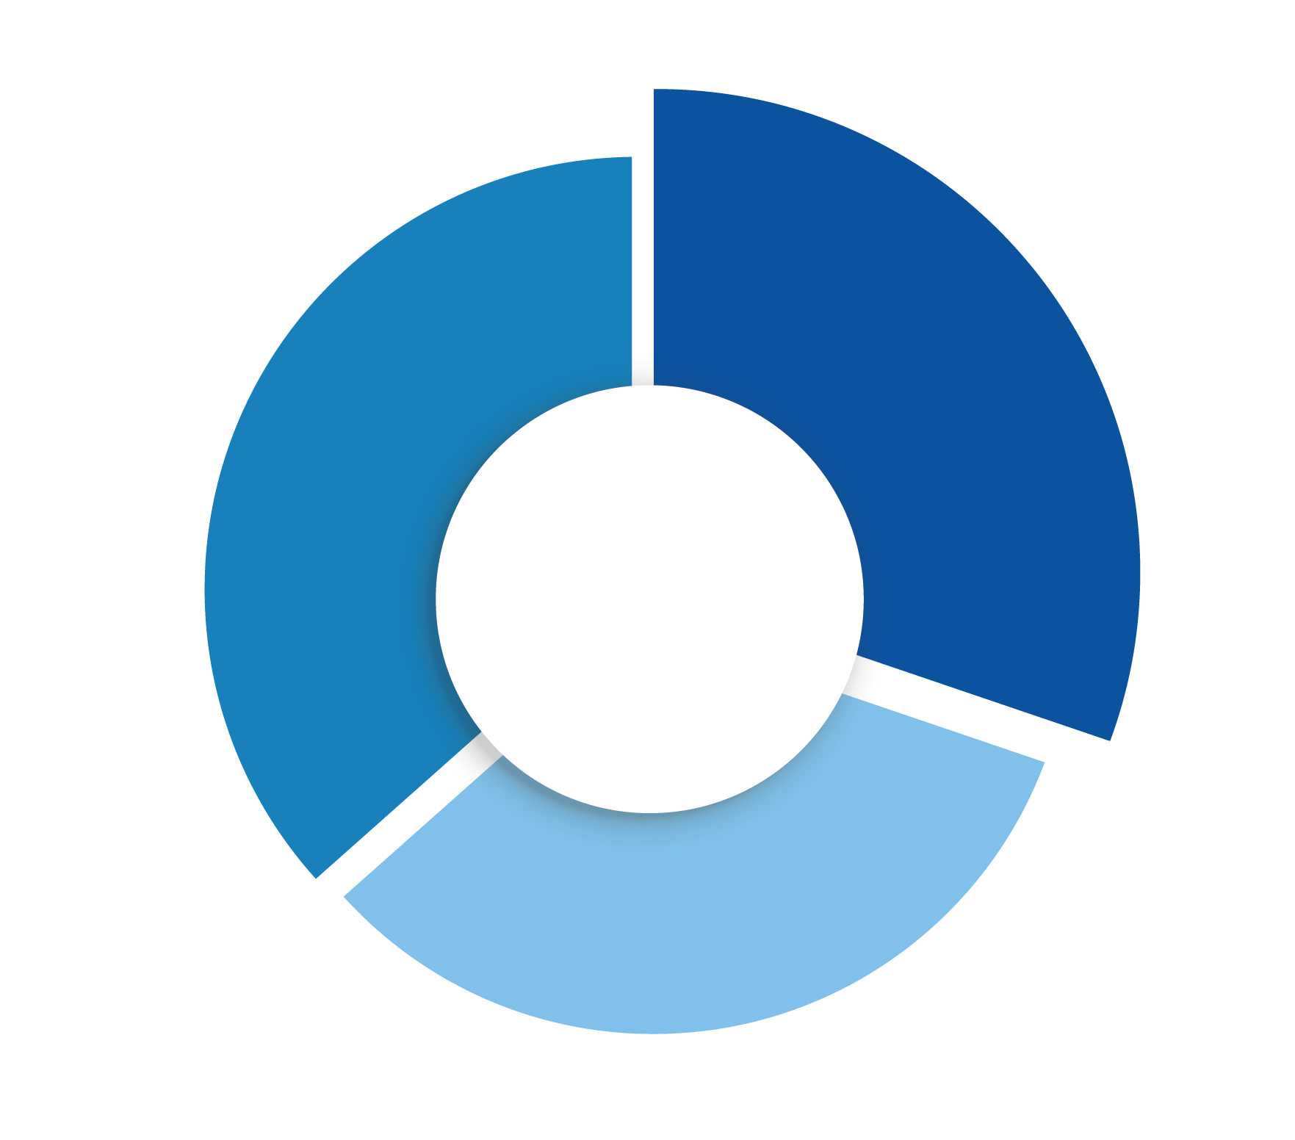



ACTIVATE INNOVATION
ACTIVATE INNOVATION
Customer Centricity
GROW YOUR BUSINESS
Future Proofing
Change Agile
INSPIRE OUR PEOPLE

Slide 31

Customer Centricity
Works to delight internal and external customers with exceptional service and products, acting as a trusted advisor.

Slide 32
Customer Centricity
Works to delight internal and external customers with exceptional service and products, acting as a trusted advisor.
Level 1 (G & H)
Collates customer insights and feedback and articulates customer expectations clearly to anticipate customer needs.
Provides direction, monitors and provides feedback to ensure team members are providing optimal customer experience.
Establishes and maintains effective customer relationships.
Leverages and engages with key stakeholders that can help drive customer requirements.

Slide 33
Customer Centricity
Works to delight internal and external customers with exceptional service and products, acting as a trusted advisor.
Level 2 (I & J)
Collates customer insights and market trends to drive decisions around new business initiatives and offerings.
Puts the customer in the heart of design in building and delivering solutions (including services and products).
Takes short-, medium- and long-term perspectives when building relationships with key customers and stakeholders.
Maintains a balance between business and customer needs.

Slide 34
Customer Centricity
Works to delight internal and external customers with exceptional service and products, acting as a trusted advisor.
Level 3 (K & L)
Creates and drives a culture of customer centricity.
Defines customer success metrics, benchmarking current performance with external market and Global Customer Trends.
Drives strategic initiatives, that are rooted in customer data analytics, socioeconomic understanding and current market trends.
Cultivates enriching diplomatic relationships.

Slide 35
Customer Centricity
Works to delight internal and external customers with exceptional service and products, acting as a trusted advisor.
Level 1 (G & H)
Level 2 (I & J)
Level 3 (K & L)
Collates customer insights and feedback and articulates customer expectations clearly to anticipate customer needs.
Provides direction, monitors and provides feedback to ensure team members are providing optimal customer experience.
Establishes and maintains effective customer relationships.
Leverages and engages with key stakeholders that can help drive customer requirements.
Collates customer insights and market trends to drive decisions around new business initiatives and offerings.
Puts the customer in the heart of design in building and delivering solutions (including services and products).
Takes short-, medium- and long-term perspectives when building relationships with key customers and stakeholders.
Maintains a balance between business and customer needs.
Creates and drives a culture of customer centricity.
Defines customer success metrics, benchmarking current performance with external market and Global Customer Trends.
Drives strategic initiatives, that are rooted in customer data analytics, socioeconomic understanding and current market trends.
Cultivates enriching diplomatic relationships.

Slide 36
Customer Centricity
Resources
How am I planning to leverage the Leadership Behaviors to be more customer centric?
How can I reset my actions using the Leadership Behaviors to amplify customer centricity?
Additional Resources - Articles
Click on each article to learn more.
Hays-improve-customer-centricity-leadership-team
KPMG-Customer First
Break the NPS Plateau: Create a Culture of Customer Experience (gallup.com)
Prediction: The future of customer experience | McKinsey
How am I planning to create a better customer impact using the Leadership Behaviors?
How would I plan to enhance this mindset with my team members?

Slide 37

Future Proofing
Demonstrate an unquestionable willingness to learn everyday, un-learn old approaches, and partner with others to assist them in doing the same.

Slide 38
Future Proofing
Demonstrate an unquestionable willingness to learn everyday, un-learn old approaches, and partner with others to assist them in doing the same.
Level 1 (G & H)
Shows curiosity to stay up-to-date with relevant knowledge and skills for the future.
Encourages curiosity within team members to reinforce learning within the team.
Enables team members with the right opportunities and resources to learn on their job.
Is able to grasp new and relevant technologies, processes and learnings.

Slide 39
Future Proofing
Demonstrate an unquestionable willingness to learn everyday, un-learn old approaches, and partner with others to assist them in doing the same.
Level 2 (I & J)
Anticipates future trends and implications accurately.
Defines key skills, tools and resources required for future success.
Demonstrates agility to learn new approaches.
Develops the mindset within the team, to continuously develop their skills and capabilities.
Applies technology and innovative approaches to achieve better results.

Slide 40
Future Proofing
Demonstrate an unquestionable willingness to learn everyday, un-learn old approaches, and partner with others to assist them in doing the same.
Level 3 (K & L)
Sees the bigger picture, constantly imagining future scenarios and creating strategies to sustain competitive advantage.
Builds a future focused talent and succession plan that optimizes the talent pipeline.
Formulates a road map, outlining the skills/roles that are required for future success, and how to optimize the current workforce to achieve the vision.
Demonstrates authenticity to admit shortfalls and allows the space to leverage team expertise.

Slide 41
Future Proofing
Demonstrate an unquestionable willingness to learn everyday, un-learn old approaches, and partner with others to assist them in doing the same.
Level 1 (G & H)
Level 2 (I & J)
Level 3 (K & L)
Shows curiosity to stay up-to-date with relevant knowledge and skills for the future.
Encourages curiosity within team members to reinforce learning within the team.
Enables team members with the right opportunities and resources to learn on their job.
Is able to grasp new and relevant technologies, processes and learnings.
Anticipates future trends and implications accurately.
Defines key skills, tools and resources required for future success.
Demonstrates agility to learn new approaches.
Develops the mindset within the team, to continuously develop their skills and capabilities.
Applies technology and innovative approaches to achieve better results.
Sees the bigger picture, constantly imagining future scenarios and creating strategies to sustain competitive advantage.
Builds a future focused talent and succession plan that optimizes the talent pipeline.
Formulates a road map, outlining the skills/roles that are required for future success, and how to optimize the current workforce to achieve the vision.
Demonstrates authenticity to admit shortfalls and allows the space to leverage team expertise.

Slide 42
Future Proofing
Resources
Am I using the Leadership Behaviors to get my business future proofed?
How can I reset my actions using the Leadership behaviors to be future centric?
Additional Resources - Articles
Click on each article to learn more.
Forbes-How To Future-Proof Your Organization
MichaelPage-Future of Leadership
McKinsey-Getting Ready for the Future of Work
The Future of Sales and Marketing is here
How can my business outcomes be impacted through my future proofing plans? Are my plans realistic and viable?
How would I plan to ‘future proof’ my team members?

Slide 43

Change Agile
Anticipate and lead change: adapt actions, accordingly, demonstrate tolerance for ambiguity; has comfort with uncertainty. Shows flexibility in adjusting own views and objectives in order to achieve a shared goal.

Slide 44
Change Agile
Anticipate and lead change: adapt actions, accordingly, demonstrate tolerance for ambiguity; has comfort with uncertainty. Shows flexibility in adjusting own views and objectives in order to achieve a shared goal.
Level 1 (G & H)
Demonstrates emotional and social awareness, while managing self and enabling the team during change.
Demonstrates adaptability and resilience to evolving changing situations.
Executes required changes due to evolving business requirements.

Slide 45
Change Agile
Level 2 (I & J)
Anticipate and lead change: adapt actions, accordingly, demonstrate tolerance for ambiguity; has comfort with uncertainty. Shows flexibility in adjusting own views and objectives in order to achieve a shared goal.
Understands the need for change and enables plans to ensure execution.
Acts as an advocate and role model for change.
Leverages social and emotional intelligence to support teammates and colleagues through change.
Identifies and communicates wins, milestones, and achievements.
Effectively integrates change into in the processes and systems to sustain the change.
Demonstrates an open mind and flexibility to course adjust and the business needs change.

Slide 46
Change Agile
Anticipate and lead change: adapt actions, accordingly, demonstrate tolerance for ambiguity; has comfort with uncertainty. Shows flexibility in adjusting own views and objectives in order to achieve a shared goal.
Level 3 (K & L)
Calibrates and applies emerging trends to proactively anticipate change, while seeking to address future desired state.
Sets the burning platform for change and drives from the front.
Thinks holistically about change.
Creates a space for experimenting, failing fast, to be able to recover and reset.

Slide 47
Change Agile
Anticipate and lead change: adapt actions, accordingly, demonstrate tolerance for ambiguity; has comfort with uncertainty. Shows flexibility in adjusting own views and objectives in order to achieve a shared goal.
Level 1 (G & H)
Level 2 (I & J)
Level 3 (K & L)
Demonstrates emotional and social awareness, while managing self and enabling the team during change.
Demonstrates adaptability and resilience to evolving changing situations.
Executes required changes due to evolving business requirements.
Understands the need for change and enables plans to ensure execution.
Acts as an advocate and role model for change.
Leverages social and emotional intelligence to support teammates and colleagues through change.
Identifies and communicates wins, milestones, and achievements.
Effectively integrates change into in the processes and systems to sustain the change.
Demonstrates an open mind and flexibility to course adjust and the business needs change.
Calibrates and applies emerging trends to proactively anticipate change, while seeking to address future desired state.
Sets the burning platform for change and drives from the front.
Thinks holistically about change.
Creates a space for experimenting, failing fast, to be able to recover and reset.

Slide 48
Change Agile
Resources
How can I use the ‘Change Agile’ Leadership Behaviors to drive the business agenda?
What are those workplace actions that I can reset with the help of the change agile behaviors?
Additional Resources - Articles
Click on each article to learn more.
McKinsey-Leading Agile Transformation-The new capabilities leaders need to build 21st-century organizations
BCG-Do You Have the Courage to Be an Agile Leader?
The Leadership Agility Factor
How to build Change capability with structure and intent?
How can I accelerate some of my business outcomes by being more change agile?
What could you be doing more to support your team be more change agile?

Slide 49
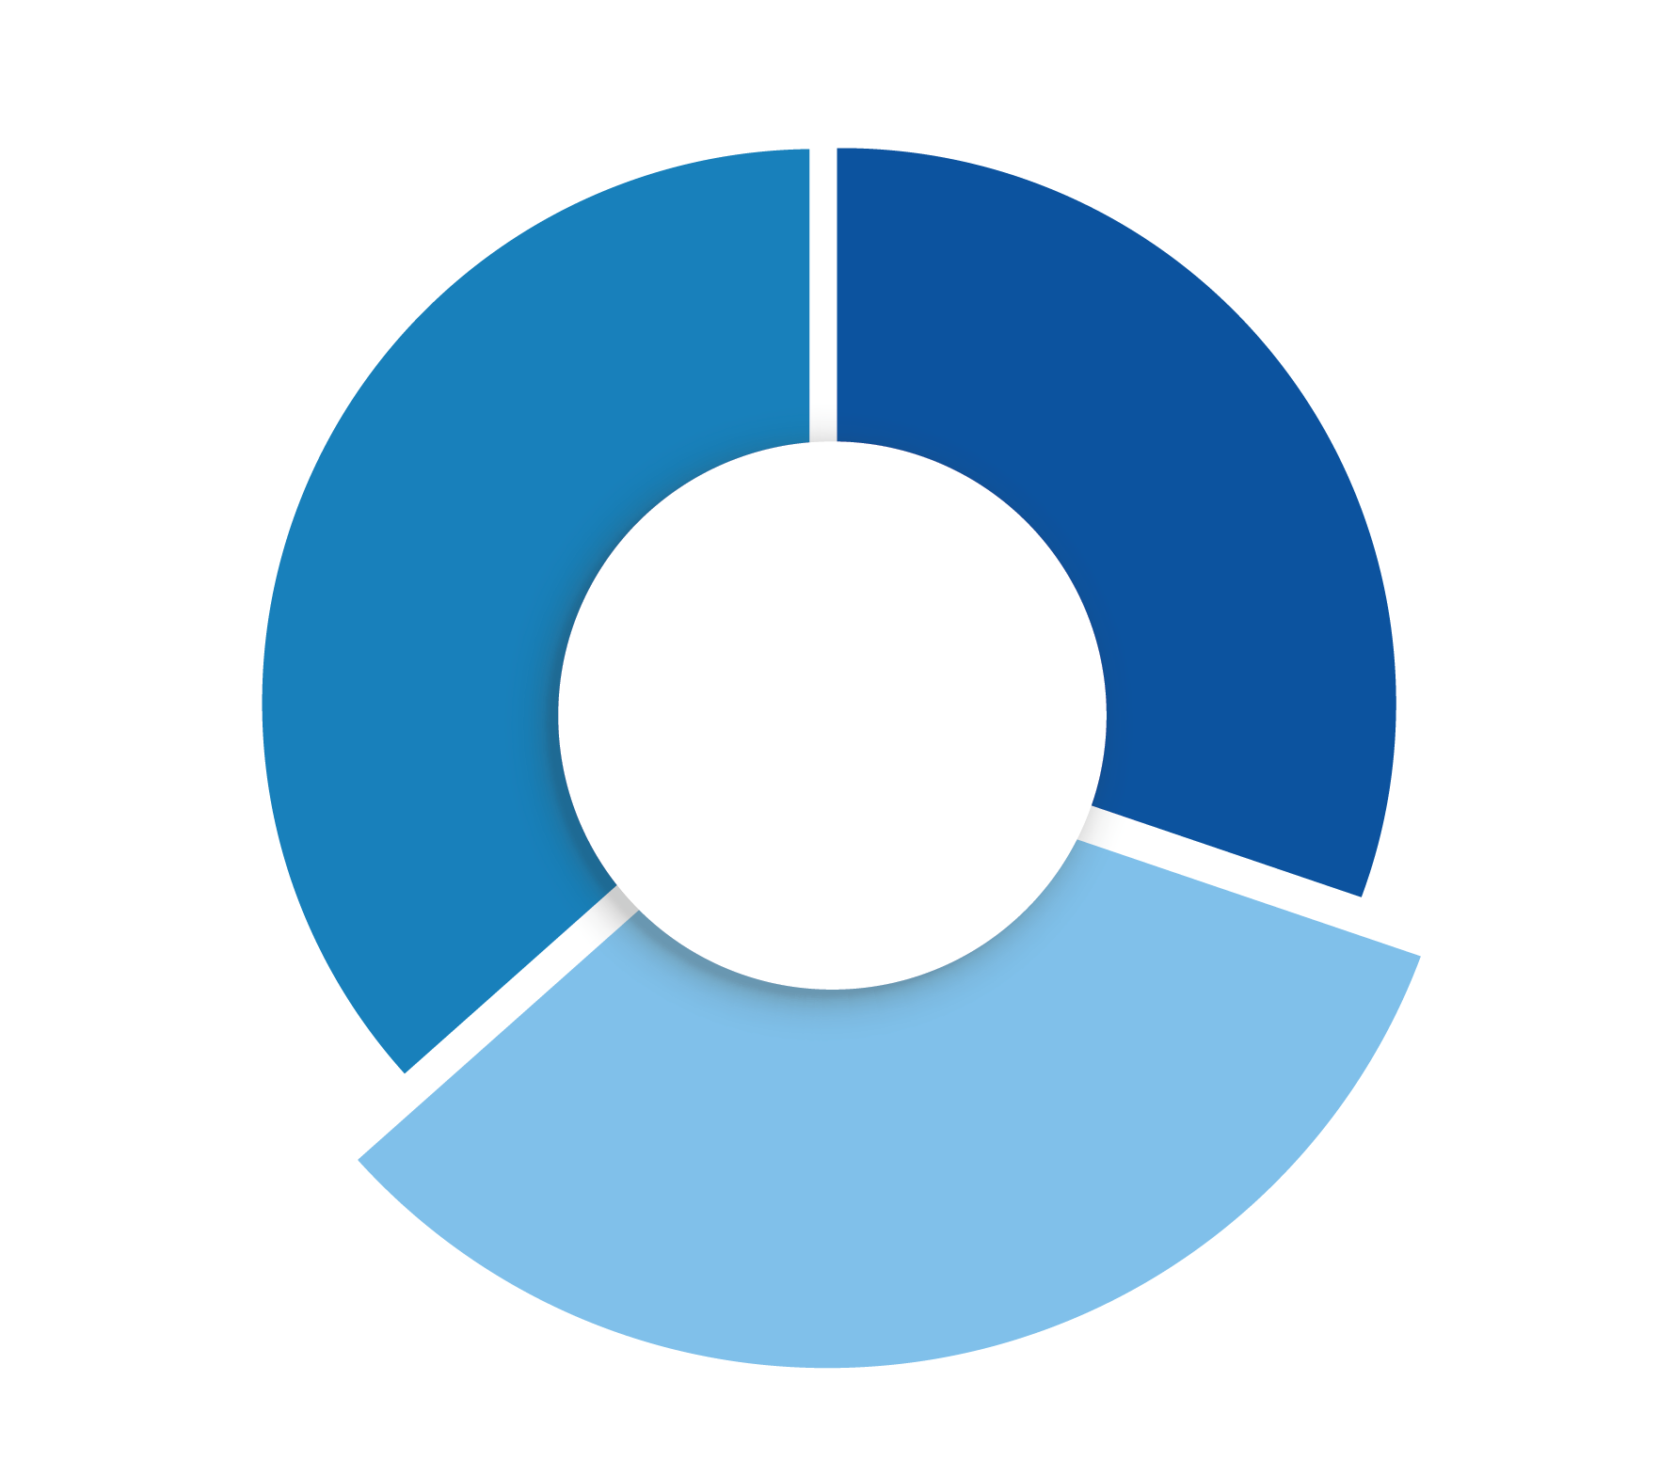


INSPIRE OUR PEOPLE
INSPIRE OUR PEOPLE
GROW YOUR BUSINESS
Engaging Leadership
Influence and Challenge
INSPIRE OUR PEOPLE

Slide 50

Engaging Leadership
Inspire people through a compelling vision fueled by a culture of support, enablement and empathy. Building a safe environment for employees to be at their best, feel included and valued.

Slide 51
Engaging Leadership
Level 1 (G & H)
Inspire people through a compelling vision fueled by a culture of support, enablement and empathy. Building a safe environment for employees to be at their best, feel included and valued.
Fosters a sense of team spirit, alignment, and purpose.
Treats people fairly and considerately at work.
Engages and enables, team members to grow.
Adapts behavioral style to different personality styles.
Listens and empathizes before responding to situations.
Demonstrates understanding of their own impact on others.

Slide 52
Engaging Leadership
Level 2 (I & J)
Inspire people through a compelling vision fueled by a culture of support, enablement and empathy. Building a safe environment for employees to be at their best, feel included and valued.
Leverages emotional intelligence, while building trust and alignment with team members, stakeholders and customers.
Empowers others and shows a genuine interest in seeing the team members grow and flourish.
Leads with empathy and consideration during difficult situations, while advocating for healthy conflict.
Promotes a collaborative work environment.
Facilitates the connection between people's motivators and organizational goals.
Recognizes and encourages contributions of others.
Is able to bring learning out of all situations, including mistakes and failure.

Slide 53
Engaging Leadership
Level 3 (K & L)
Inspire people through a compelling vision fueled by a culture of support, enablement and empathy. Building a safe environment for employees to be at their best, feel included and valued.
Passionately communicates the vision and gains alignment and acceptance.
Creates a compelling environment that enables managers and leaders to support others to be their best at work.
Inspires and role models engagement inclusion and empathy.
Drives an open communication 'speak-up' culture.
Champions a learning culture, where reflection on wins and misses are capitalized on, in all that we do.
Role models and demands trustworthy behavior from others.

Slide 54
Engaging Leadership
Inspire people through a compelling vision fueled by a culture of support, enablement and empathy. Building a safe environment for employees to be at their best, feel included and valued.
Level 1 (G & H)
Level 2 (I & J)
Level 3 (K & L)
Fosters a sense of team spirit, alignment, and purpose.
Treats people fairly and considerately at work.
Engages and enables, team members to grow.
Adapts behavioral style to different personality styles.
Listens and empathizes before responding to situations.
Demonstrates understanding of their own impact on others.
Leverages emotional intelligence, while building trust and alignment with team members, stakeholders and customers.
Empowers others and shows a genuine interest in seeing the team members grow and flourish.
Leads with empathy and consideration during difficult situations, while advocating for healthy conflict.
Promotes a collaborative work environment.
Facilitates the connection between people's motivators and organizational goals.
Recognizes and encourages contributions of others.
Is able to bring learning out of all situations, including mistakes and failure.
Passionately communicates the vision and gains alignment and acceptance.
Creates a compelling environment that enables managers and leaders to support others to be their best at work.
Inspires and role models engagement inclusion and empathy.
Drives an open communication 'speak-up' culture.
Champions a learning culture, where reflection on wins and misses are capitalized on, in all that we do.
Role models and demands trustworthy behavior from others.

Slide 55
Engaging Leadership
Resources
In which situations should I be leveraging the Engaging Leadership style to achieve a better outcome?
What actions and behaviors can I focus on strengthening in my working style to be more engaging?
Additional Resources - Articles
Click on each article to learn more.
Adapt your leadership style to your situation
15 Ways To Promote Psychological Safety At Work (forbes.com)
How the most successful leaders will thrive in an exponential world
What impact (on my team/ my customer base/ the business) am I hoping for, if I lead with a more engaging style?
What’s the one thing you can do differently today, to be a more engaging leader to your team?

Slide 56

Influence
& Challenge
Create positive momentum by persuading the organization, demonstrating personal courage, and an ability to durably align different opinions.

Slide 57
Influence & Challenge
Level 1 (G & H)
Create positive momentum by persuading the organization, demonstrating personal courage, and an ability to durably align different opinions.
Articulates opinions and is willing to question the status quo in a compelling manner that gains buy in from stakeholders.
Demonstrates clear self-awareness of their impact while communicating.
Develops credibility with peers, leaders, and juniors.

Slide 58
Influence & Challenge
Level 2 (I & J)
Create positive momentum by persuading the organization, demonstrating personal courage, and an ability to durably align different opinions.
Demonstrates gravitas, emotional intelligence and credibility to impact decisions.
Balances and effectively aligns the interests of multiple stakeholders, ensuring that priority and focus is given where due.
Influences other to take action.
Negotiates skillfully in tough situations, wins concessions without damaging relationships.
Intentionally develops and leverages own internal and external network.

Slide 59
Influence & Challenge
Create positive momentum by persuading the organization, demonstrating personal courage, and an ability to durably align different opinions.
Level 3 (K & L)
Demonstrates political savviness while dealing and considering interests of different stakeholders.
Maintains frequent interactions with a broad stakeholder network and takes a proactive approach to shape and influence stakeholder expectations, both upwards and downwards.
Ability to bring consensus amongst teams and departments to move the agenda forward.

Slide 60
Influence & Challenge
Create positive momentum by persuading the organization, demonstrating personal courage, and an ability to durably align different opinions.
Level 1 (G & H)
Level 2 (I & J)
Level 3 (K & L)
Articulates opinions and is willing to question the status quo in a compelling manner that gains buy in from stakeholders.
Demonstrates clear self-awareness of their impact while communicating.
Develops credibility with peers, leaders, and juniors.
Demonstrates gravitas, emotional intelligence and credibility to impact decisions.
Balances and effectively aligns the interests of multiple stakeholders, ensuring that priority and focus is given where due.
Influences other to take action.
Negotiates skillfully in tough situations, wins concessions without damaging relationships.
Intentionally develops and leverages own internal and external network.
Demonstrates political savviness while dealing and considering interests of different stakeholders.
Maintains frequent interactions with a broad stakeholder network and takes a proactive approach to shape and influence stakeholder expectations, both upwards and downwards.
Ability to bring consensus amongst teams and departments to move the agenda forward.

Slide 61
Influence & Challenge
Resources
What behaviors can I leverage in my own management style that can inspire and influence people while tackling business challenges?
What actions and behaviors should I embed in my daily operating style to support my ability to inspire and influence others?
Additional Resources - Articles
Click on each article to learn more.
The 5 key traits of persuasive leaders
How to develop and master executive presence?
Mentorship as a tool to inspire the next generation
How To Establish Credibility: 4 Strategies Leaders Always Use (forbes.com)
How intentional am I being in building my network for today, tomorrow and the future?
What else should I know about my team members, to influence and inspire them further.

